Slide 1
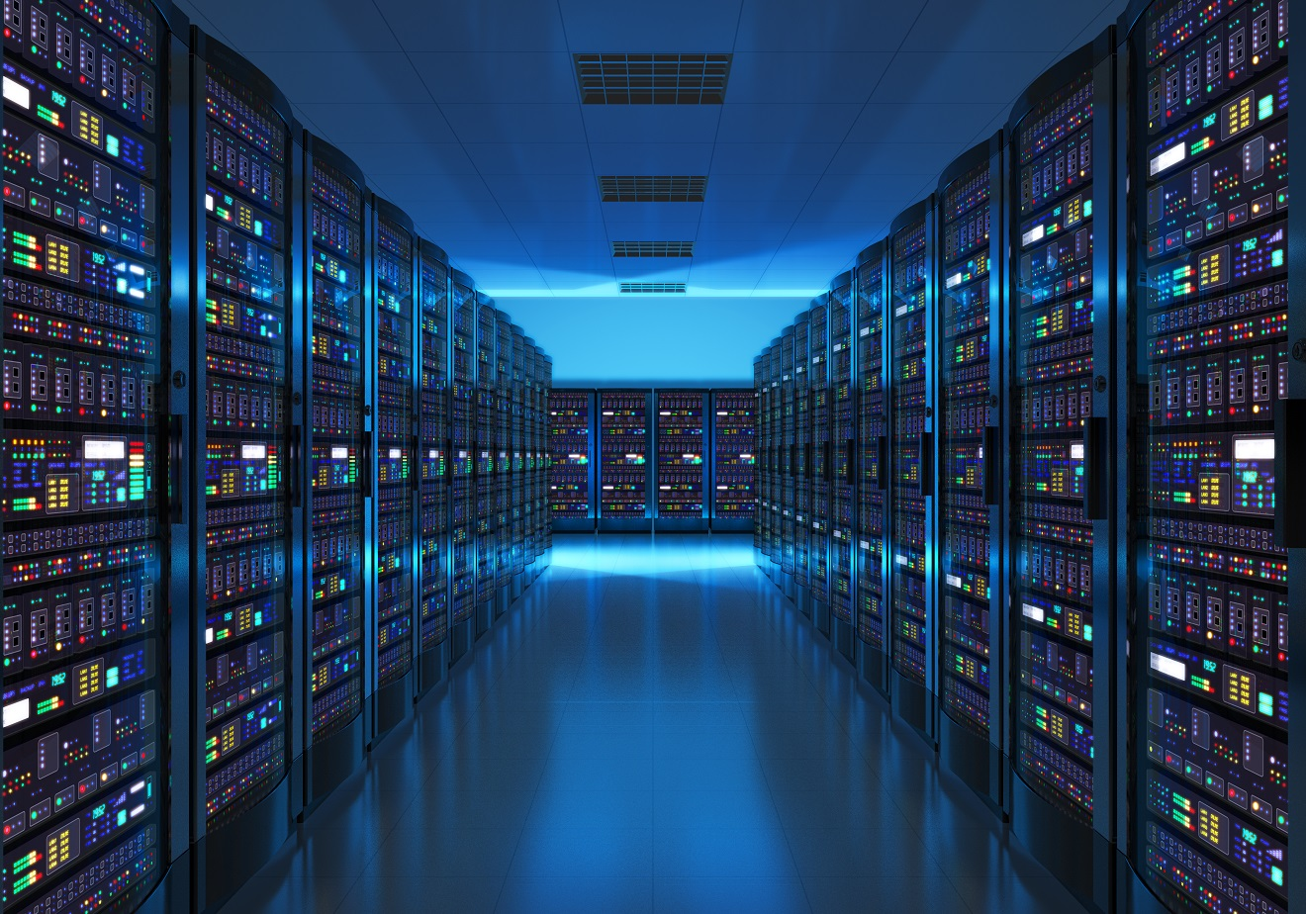
SERVERS

Slide 2
Servers
What is a server? A server is a high-performance computer, designed to perform other tasks. A common computer is usually used only by one person through an intuitive operating system with the aim of running everyday applications, such as spreadsheets, word processors, emails or Internet browsers. Instead, the servers work with a specialized operating system and built to support various users. They are designed to operate large-scale applications, such as multiple email accounts, instant messaging applications, printer servers, calendar sharing programs, various databases, enterprise resource planning, and customer relationship management software. Classification of servers Stateful servers: A stateful server can remember the information between requests. The scope of this information can be global or session-specific. Stateless servers: A stateless (Stateless) server does not store any information between requests. Concurrent servers: A concurrent server serves multiple clients at the same time, and more so, while it is serving, it continues to listen. The problem is that every customer has to wait their turn to be taken care of. It's about creating a new process or execution line every time a customer "gets" to order a service. EXAMPLE: An HTTP server for static HTML pages is an example of a stateless server while Apache Tomcat is an example of a stateful server.

Slide 3
Types are most common servers
Application Servers Contaq Nomipaq Java EE: Jboss WebSphere - IBM Web Servers IIS (Internet Information Server): The Web Server (IIS) role in Windows Server 2012 provides a secure, easy-to-manage, modular, and extensible platform for hosting websites, services, and applications reliably. With IIS 8, you can share information with users on the Internet, on an intranet, or on an extranet. IIS 8 is a unified web platform that integrates IIS, ASP.NET, FTP, PHP, and Windows Communication Foundation (WCF) services. Apache -Tomcat: is a web container with servlet and JSPs support. Tomcat is not an application server, such as JBoss or JOnAS. It includes the Jasper compiler, which compiles JSPs by converting them to servlets. The Tomcat servlet engine is often presented in combination with the Apache web server. For simplicity, we could say that Apache Tomcat (or Jakarta Tomcat) is a software developed with Java (so it can work on any operating system, with its corresponding java virtual machine) that serves as a web server with support for servlets and JSPs. Virtualization Servers XenServer (CITRIX)
Vmware
HyperV
KVM (Linux)
Database servers SQL Server
Oracle
MySql

Slide 4
Server infrastructure
Tower Servers:
This type of server is the most basic on the market. It is similar to a common desktop in terms of cost and space. They are vertical and independent drives that contain all the traditional components of a server: hard disk, motherboard, CPUs, network board, wiring, and so on. There is also the possibility to add a hard disk for Direct Attached Storage (DAS) to the server. Tower servers are great for small businesses that have limited space and require centralizing their data processing system into their own storage room.
Many experts recommend that the first server in a company that is starting its operations is a Tower server, as IT will be able to tailor the number of hard drives and processors on the server to your needs. For example, companies with fewer than 25 collaborators need a server with 1 processor and 2 or 4 hard drives, while a company with more partners will need to install more processors and hard drives on the server. This flexibility is one of the great advantages of this type of server. In addition, tower servers often produce less noise, as they don't need many coolers to function.

Slide 5
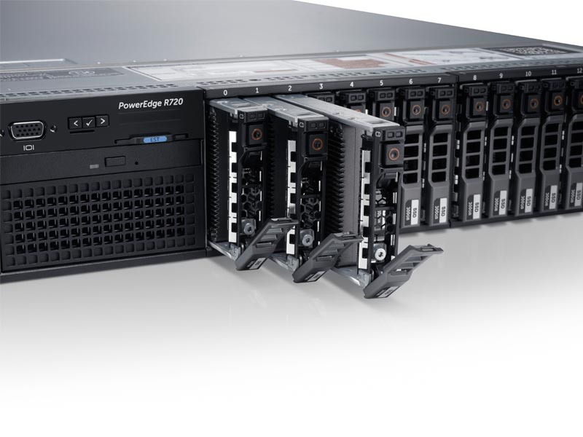
Rack Servers The Rack server is a model that has expansion slots, known as mezzanine slots, to add network interface cards, among other things. This configuration uses space efficiently and provides centralized management of cables and servers. In addition, configuring a Rack server increases the scalability of the infrastructure by allowing you to add new servers as needed and connect them all to external storage such as a network-attached storage center (NAS) or storage area network (SAN).
It is important to note that Rack servers are limited in terms of the number of additional drives and memory cards that can be installed. They are generally more flexible than Blade servers because they have less tight integration. They are ideal for data centers with external storage, offering maximum computational power with intelligent design when it comes to leveraging space. Another important point is that these servers operate very close to each other, so they require more cooling than Tower servers. Fans can make a lot of noise, and the company will also need to have a climate control system to keep the Rack at the ideal temperature. That's why many companies isolate Rack servers in a special room. Maintaining such a server is also more difficult because it must be physically removed from the Rack for this purpose.

Slide 6
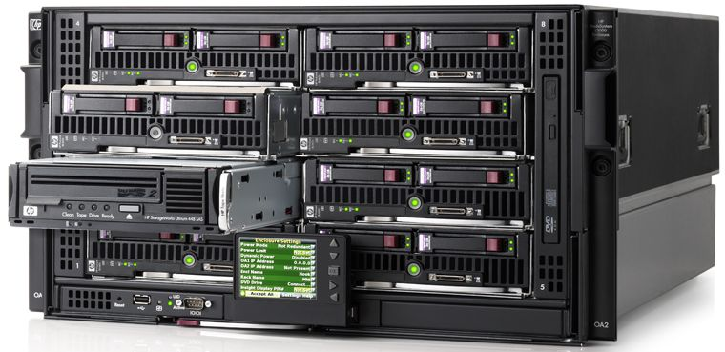
Blade Servers
These servers are shaped like small boxes and projected into modules, allowing more servers to be accommodated in a smaller space. A Blade enclosure consists of Blade servers, data storage equipment, power components, cooling and ventilation unit, network, and others. All controlled by an integrated management system. The main difference between a Rack server and a Blade server is that multiple Blade servers can operate in a chassis. So adding a new server is as simple as adding a new sheet to the chassis or enclosure. You can also add other network components, such as Ethernet switches, firewalls, and load balancers within the same server enclosure. Blade infrastructure generally requires less rack space than Rack servers. It uses less power per server because servers share power and cooling, reducing heat and cooling costs. There is only one cable through the chassis, which in turn supplies all the power, cooling, inputs and outputs and connectivity for all devices in the enclosure, so you don't need to install new cables when you add a component.
Some Blade enclosures are able to increase the number of servers in a company by more than 60%. Therefore, they are ideal for companies with a greater number of collaborators and that use greater data processing or storage capacity, as these servers offer more computational power by optimizing space, power and the cooling system.

Slide 7
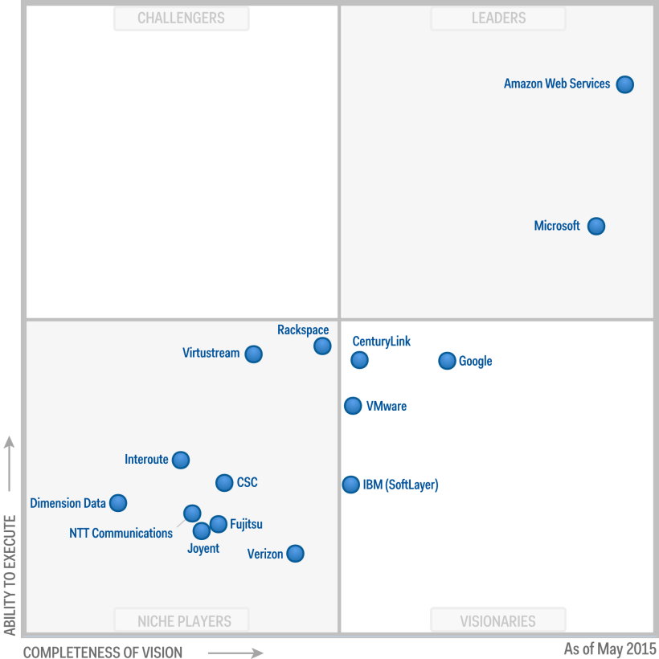
Cloud
Using Cloud Computing to manage and store company files is a good option that offers a number of benefits. For those who are starting this technology does not require a large investment and, theoretically, a smaller IT team will be needed to manage the server, which is suitable for the needs and availability of small and medium-sized businesses. The company will also have no concerns about outdated or outdated hardware or software. The most important thing is that the supplier chosen by the company is stable and reliable. If the server is running on a Cloud Computing platform and there is a cut in the Internet connection, collaborators will lose access to company applications and data. This means that they won't be able to share files or work for a certain period of time, which will decrease their productivity.
When a company stores its data on the computers of a third-party vendor it loses the power to manage it and will have to worry more about the security and privacy of its corporate data. In addition, despite the previous savings on account of outsourcing services (avoiding costs of contracting an IT team, continuous maintenance and investment in new equipment), it should be noted that such expenses may exist indirectly in the long term, as they will be included in the amounts of fees charged by the supplier.

Slide 8
Virtualization
this technology can bring a variety of benefits because it enables more efficient utilization of IT resources. Virtualization enables a server to work as if it were a pool, each with its own operating system and a number of unique applications. A virtual machine is in fact software, even if it has all the components of a physical machine. It has a motherboard, a CPU, a hard drive, a network controller and so on. The operating system and other applications on a virtual machine work in the same way as on a physical machine. Another important detail is that in virtualization a program known as a hypervisor places a layer of abstraction between the operating system and the hardware. This means that the hypervisor can operate multiple virtual machines with the same operating system or even different operating systems on the same physical server.

Slide 9
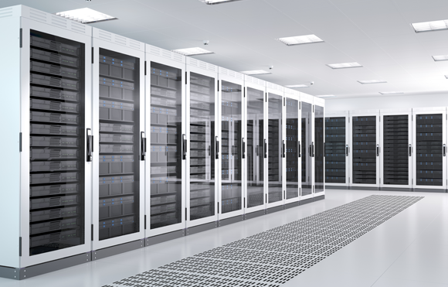
Data Center
Data Center, or Data Processing Center (CPD), is a designed environment for concentrating servers, data processing and storage equipment, and network asset systems, such as switches, routers, and others. Therefore, it is considered the nervous system of companies.

Slide 10
Data Centers must have some basic components to be properly functioning. These are: Network Infrastructure Physical Security
Ensure physical protection of the site: Build the walls, doors and windows of the Data Center in such a way that they provide additional security even against natural disasters. Install Racks: With these structures it is possible to ensure more security for switches, routers and hard drives, among other components of the DC. Install electronic access control systems: this way access to all points in the Data Center will be protected by electronic access control mechanisms that will only allow authorized persons to enter the establishment. Create a provisioning process: Any individual requesting access to the Data Center must be registered in a system to ensure data security. Install alarms: All areas of a Data Center must have alarms to prevent possible invasions and allow for greater effectiveness in taking providences. Organize a security team: An efficient team must be formed to perform a daily series of activities, such as monitoring alarms, training security agents for emergencies, monitoring unauthorized access, assisting all collaborators who have access to the Data Center, controlling access through confirmation of the employee's identity, as well as issuing monitoring reports, and answering telephone and radio calls. Cooling and Energy UPS
Emergency Plant Air Conditioning
Precision Comfort
By row

Slide 11
Types of data center
The technology industry distinguishes between these four types of data center.
Tier I. This is the most basic type of data center. They can only guarantee continuity of service at 99.671%. This, although it may seem like a lot, is actually the lowest there is. A Tier 1 data center may interrupt service without notice. They also do not have redundancy and cooling systems.
Tier II. Its availability is slightly higher than the previous one, 99.741%. They have redundancy systems, auxiliary power generators and elevated floors, among other advantages. However, they may still present unforeseen interruptions.
Tier III. Tier III data centers are not affected by unscheduled outages. That is, only when maintenance actions are to be performed will affected servers of that type of data center interrupt their service. They are connected to different electrical networks and have an advanced cooling system. Its availability is 99.98%. Tier IV. Tier IV is the most advanced type of data center and offers 99.995% availability. This means that they only stop for 26 minutes throughout the year. This is the highest level of availability. They have a high level of redundancy, high efficiency cooling systems. They also have complementary fiber networks and alternative power supply systems.

Slide 12
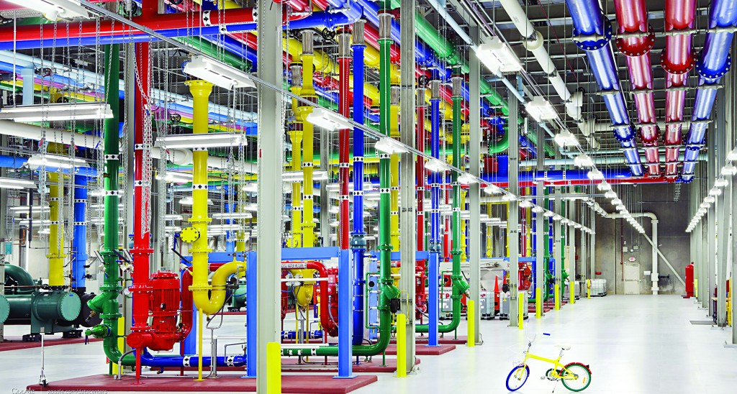
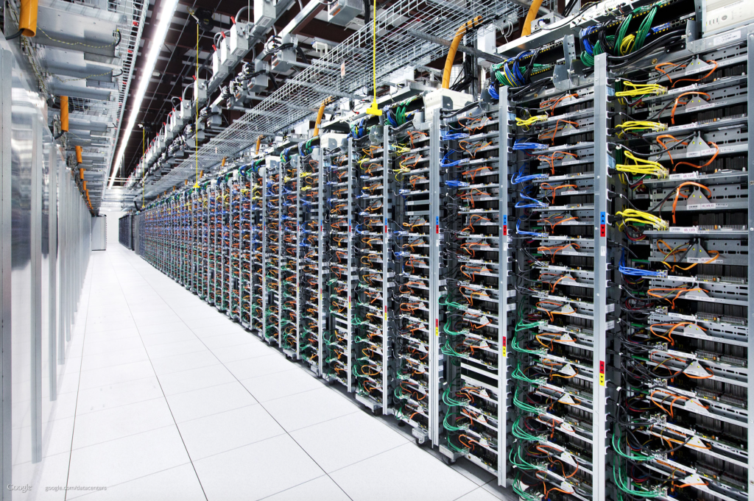
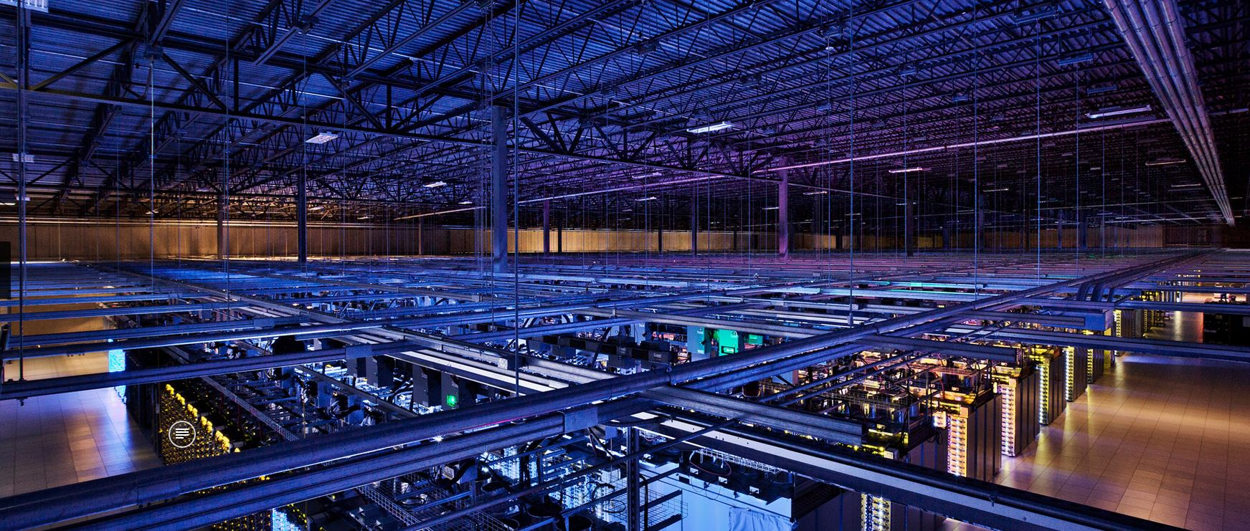

most recognized Data Centers

Slide 13
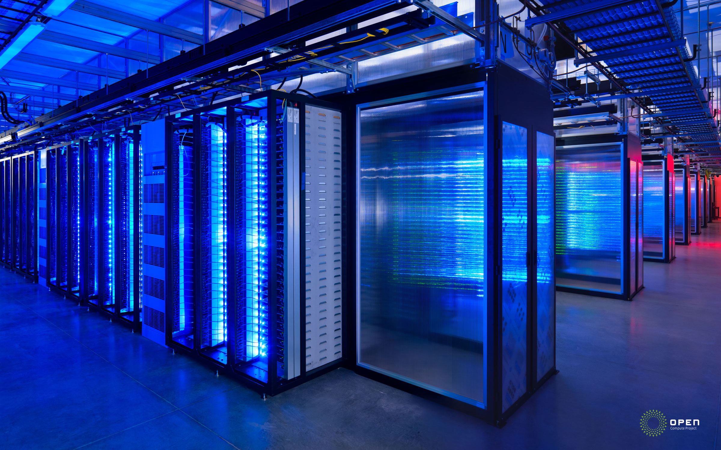

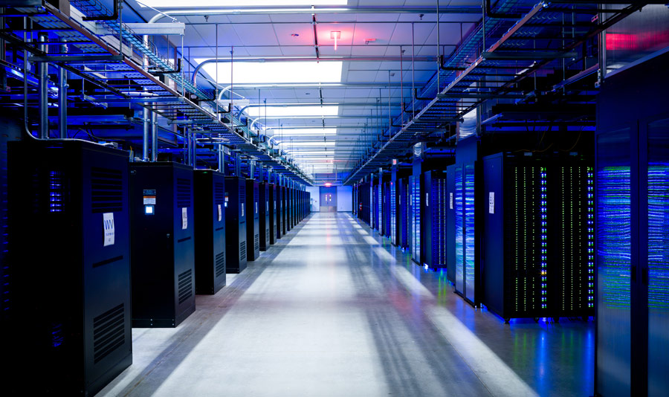

Slide 14
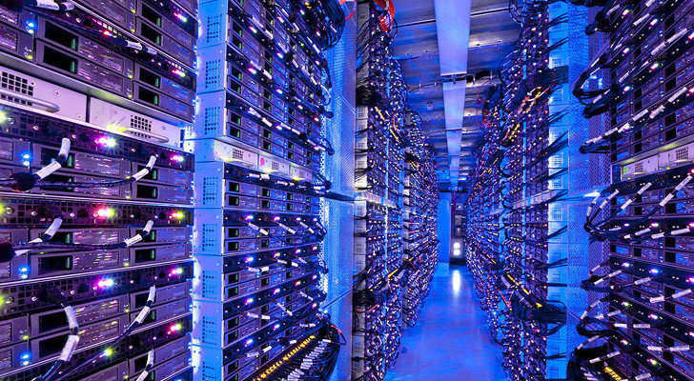
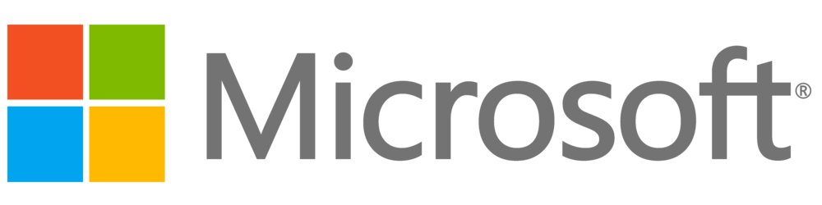
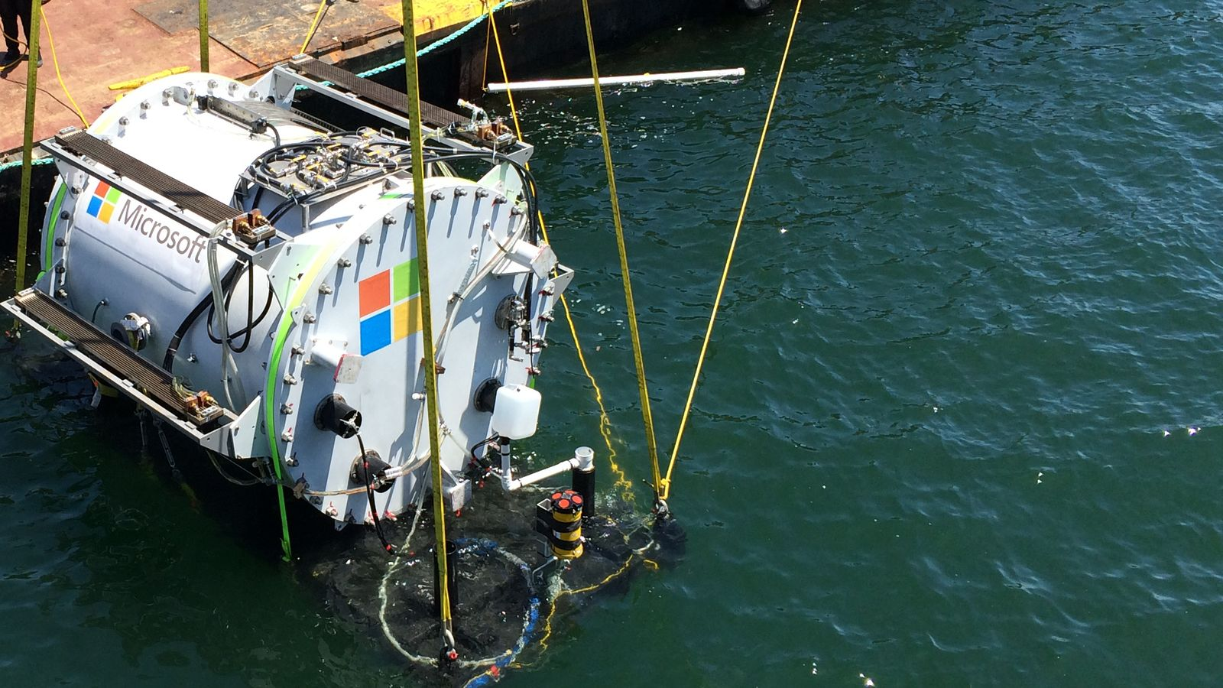

Slide 15
Storage
It's about enabling one or more hard disks on a local network, so that the data stored there remains accessible to all devices that want to use it. That way, the user not only has access to the device's own storage, but also has common storage that they share with other devices connected to that same network. The concept is simple. The issue is slightly complicated by defining how different types of data storage handle that connection to your local network. DAS
NAS
SAN

Slide 16
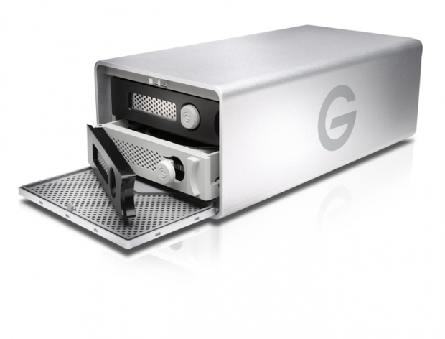
DAS storage system The DAS storage system has many things in common with the SAN system you just met. In fact, the SAN system can be considered an evolution of the DAS system. This networked storage system takes its name from direct Attached Storage or Direct Attached Storage. As the name implies, this networked storage system consists of one or more disks attached and connected directly to a server. The user of this networked storage system will see the storage space as if it were directly connected to your computer. This system is one of the simplest and easiest to implement by users because, when connected directly to the server, its configuration is quite simple.

Slide 17
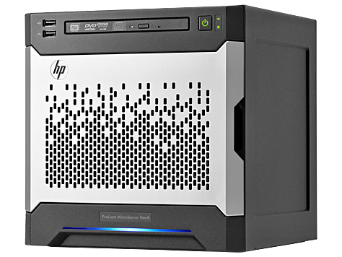
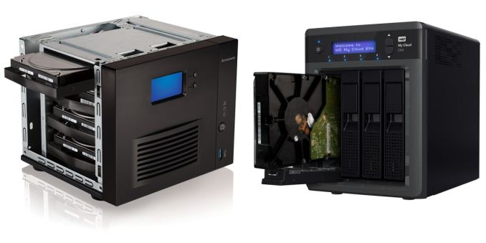
NAS storage systems The NAS storage system, which is network attached storage or network-attached storage, is becoming one of choice for small businesses and users to centralize their files and backups. This success is because, since this system incorporates its own system of connecting and receiving requests for data access, it removes the servers from the equation. NAS storage systems connect directly to the router or access point on the network and have their own entity within it. Its configuration and management is done through the TCP/IP protocol so it is possible to access the data it contains from anywhere and from any internet browser.

Slide 18
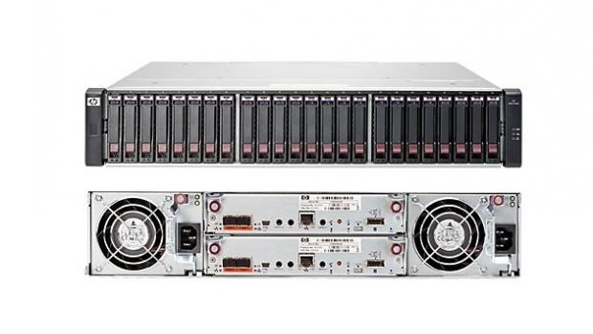
SAN: The most professional system The SAN-type network storage system takes its name from the acronym Storage Area Network or Storage Area Network. Perhaps this is the most complex network storage system of the three we have mentioned and, given this complexity in its architecture, its configuration, management and maintenance, is one of the least used by users, but the most common among large companies. This type of storage consists of connecting a series of hard drives to a controller that adds up its capabilities forming a global storage space. This system then connects to a server that manages the data that is stored in that common space and also allows connection to a local network.

Slide 19
Cloud services
Cloud Services: Software as a Service (SAAS): This is a term used to describe when users "rent" or borrow software online, rather than purchasing and installing it on their own hardware equipment. In this way, all the work of processing and storing files is done on remote servers that you access over the Internet, using a web browser. Platform as a Service (PAAS) are software platforms for which the development tool itself is hosted in the cloud and accessed through a web browser. With PaaS, developers can build web applications without having to install any additional tools on their computers, and then deploy these applications without having any specialized administrative knowledge. Infrastructure as a Service (IAAS)—Allows on-demand access to IT infrastructure. This includes resources, such as storage, networking, and processing, that you need to run your workloads. As a business user, you can request IT services whenever you need them and pay only for what you consume. SaaS, when combined with PaaS, is what is known as "cloud computing"
Infrastructure
Networks
Servers
Storage
Collaboration
Mail
Documents
Analytics
Social media Business Intelligence
Development platforms Security
Firewall
Anti Spam
Antivirus
Monitoring

